Slide 1

Blend360 Enterprise Data Intelligence Platform
Automated Data Understanding, Quality, KPIs, Visualizations & AI Chat on Snowflake

Slide 2
Overview
Blend360 Enterprise Data Intelligence Platform is an enterprise-grade AI analytics platform that automatically analyzes Snowflake data warehouses and transforms raw schemas into actionable business insights.
Instead of manual SQL, modeling, and dashboard creation, the platform uses Snowflake Cortex AI agents to:
Discover tables and relationships
Generate KPIs and charts
Assess data quality
Produce executive summaries
Enable conversational analytics

Slide 3
Problems Solved
Manual data exploration is slow and error-prone
Data quality issues are detected too late
Business users depend heavily on data teams
Insights are scattered across dashboards and tools
Our Solution
Automated schema understanding
AI-generated KPIs & charts
Built-in data quality intelligence
Natural language chat on warehouse data

Slide 4
DEMO

Slide 5
Technical Deep Dive

Slide 6

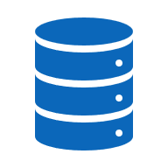
Architecture
REST APIs Calls
Multi-Agent AI System
Metadata & Profiling
New Load Analysis
/Run Analysis
Cortex AI
Relationships Agent
Information Schema & Metadata
Dashboard
/clean-report
Data Quality Agent
History Data
/clean-report/runs
KPIs Agent
Charts Suggestion Agent
Chatbot
/chat
Narrative Insights Agent
Stored in Snowflake

Slide 7
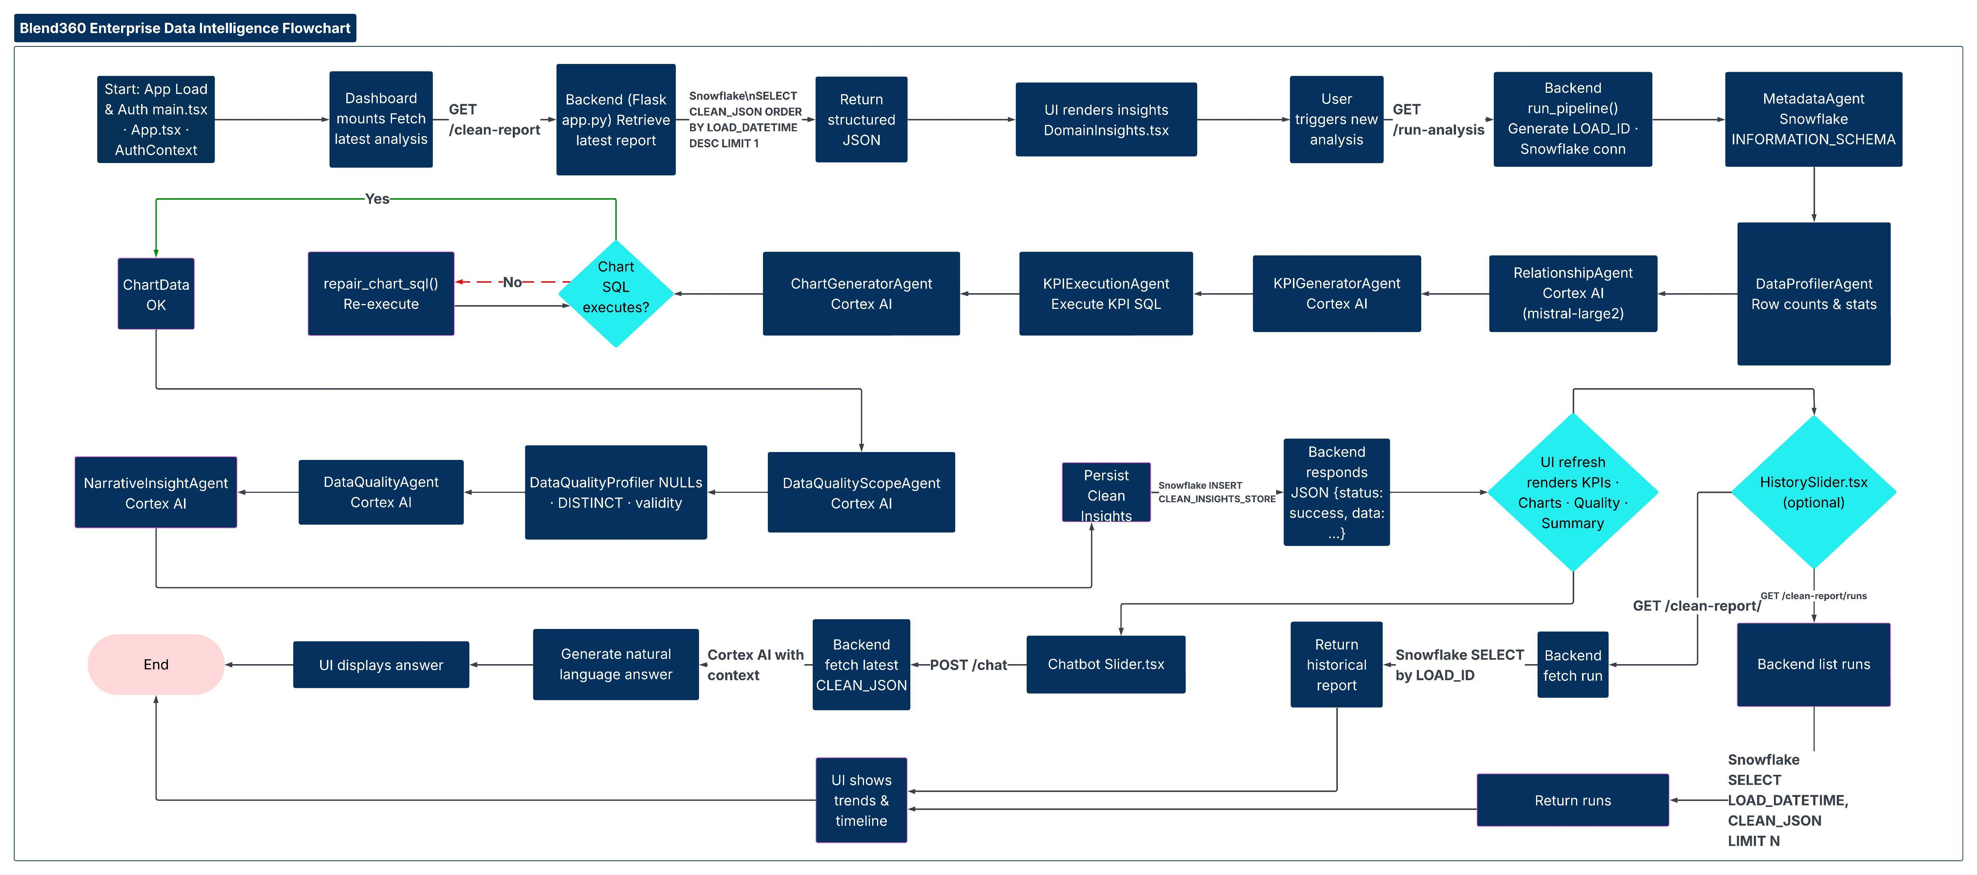
Working Flow

Slide 8





Agents Walkthrough
Relationships Agent
Data Quality & Transformation Agent
KPIs Agent
Charts Agent
Narrative Insights Agent
Automatically discovers and maps table relationships across the data warehouse using AI.
Identifies data quality issues and recommends clear, actionable transformations to improve trust.
Dynamically generates business KPIs directly from warehouse data with auto-repair.
Dynamically Suggest visualizations directly from warehouse data with auto-repair.
Transforms technical insights into clear, executive-ready summaries using AI.

